Slide 1


CYBER SECURITY
Digital Signatures
Er. Prakash Chandra Adhikari

Slide 2
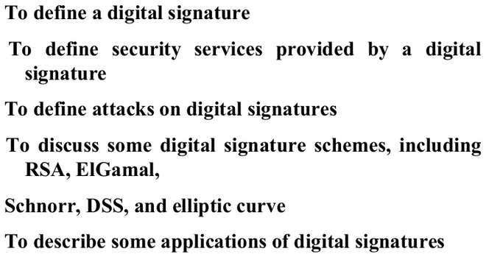
Lecture Agenda

Slide 3
Digital Signatures
Definition of Digital Signature
A digital signature is a cryptographic technique used to:
Verify the authenticity of a message
Ensure the integrity of data
Provide non-repudiation (sender cannot deny sending it)
👉 It is the electronic equivalent of a handwritten signature, but more secure.
Purpose of Digital Signatures
Digital signatures are used to:
Confirm the identity of the sender
Ensure the message has not been altered
Provide proof of origin

Slide 4
Digital Signatures
Real-Life Analogy
Signing a document or cheque proves:
It belongs to the signer
It is approved by them
Similarly:
A digital signature proves:
The message comes from the claimed sender
The message is authentic
Key Concept (Alice & Bob Example)
Alice (sender) sends a message
Bob (receiver) must verify:
Message is from Alice (not Eve)
Alice signs the message electronically
👉 This process is called a digital signature

Slide 5
Digital Signatures
Objectives of Digital Signatures
Define what a digital signature is
Identify security services provided
Understand possible attacks
Study different signature schemes:
RSA
ElGamal
Schnorr
DSS
Elliptic Curve

Slide 6
Digital Signatures
Security Services Provided
✅ Authentication
Confirms the identity of the sender
✅ Integrity
Ensures the message is not modified
✅ Non-repudiation
Sender cannot deny sending the message

Slide 7
Digital Signatures
Applications of Digital Signatures
Secure email communication
Online banking transactions
E-commerce systems
Legal digital documents
Software distribution (code signing)

Slide 8
Comparison: Conventional vs Digital Signatures
1. Inclusion
Conventional Signature
Signature is part of the document
Example: signature on a cheque
🔐 Digital Signature
Signature is separate from the document
Two items are sent:
Message
Digital signature
👉 Receiver verifies that the signature belongs to the sender ✔ If valid → message accepted ❌ If not → message rejected

Slide 9
Comparison: Conventional vs Digital Signatures
Verification Method
Conventional Signature
Compared with a stored sample signature
Requires prior record for comparison
🔐 Digital Signature
No stored copy needed
Uses mathematical verification
Verification is done using:
Message
Signature
Public key

Slide 10
Comparison: Conventional vs Digital Signatures
Relationship
Conventional Signature
One-to-many relationship
Same signature can be used on many documents
🔐 Digital Signature
One-to-one relationship
Each message has a unique signature
Signature of one message cannot be reused

Slide 11
Comparison: Conventional vs Digital Signatures
Duplicity (Copy Issue)
Conventional Signature
Copies can be distinguished from original
🔐 Digital Signature
Copies are identical to original
Cannot distinguish unless:
Timestamp or additional data is used
👉 Risk:
Attackers can reuse (replay) signed messages

Slide 12
PROCESS (Digital Signature)
🔹 Overview
The digital signature process involves:
Signing algorithm (Sender side)
Verifying algorithm (Receiver side)
Steps:
Sender signs the message using a signing algorithm
Sends:
Message (M)
Signature (S)
Receiver applies verifying algorithm
If valid → ✅ Accept message If not → ❌ Reject message

Slide 13
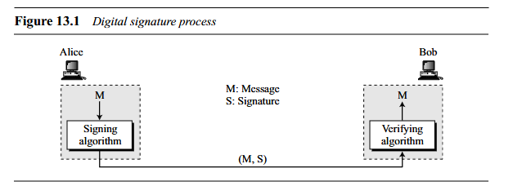
PROCESS (Digital Signature)
Diagram Explanation Flow:
Alice (Sender):
Message → Signing Algorithm → Signature
Transmission:
(Message + Signature) sent
Bob (Receiver):
Receives both → Verifies using verifying algorithm
👉 This ensures:
Message authenticity
Integrity

Slide 14
PROCESS (Digital Signature)
🔹 Need for Keys
🔑 Concept
Digital signatures use public-key cryptography
🔐 At Sender (Alice):
Uses private key to sign
🔓 At Receiver (Bob):
Uses public key of sender to verify

Slide 15
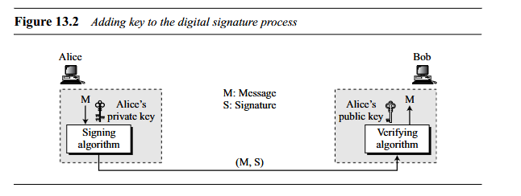
PROCESS (Digital Signature)
Diagram Explanation (Figure 13.2 – With Keys)
Process:Alice:Uses private key + signing algorithm
Bob:Uses public key + verifying algorithm
👉 Key idea:Signing = Private Key
Verification = Public Key

Slide 16
PROCESS (Digital Signature)
Why Not Use Secret (Symmetric) Key?
Using one shared key for both signing and verification is not suitable because:
Key sharing problem
Only two parties know the key
Authentication issue
Cannot prove who actually signed
Forgery risk
Receiver can fake sender’s signature
👉 Therefore:
Digital signatures require public-key system

Slide 17
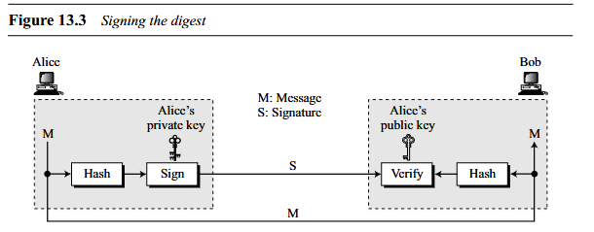
PROCESS (Digital Signature)
🔹 Signing the Digest
🔍 Problem
Public-key algorithms are slow for long messages
💡 Solution
Instead of signing full message:
Create message digest (hash)
Sign the digest

Slide 18
PROCESS (Digital Signature)
Diagram Explanation (Figure 13.3 – Signing Digest)
At Sender (Alice):
Message → Hash function → Digest
Digest → Sign using private key → Signature
Transmission:
Send:
Message (M)
Signature (S)
At Receiver (Bob):
Message → Hash → New Digest
Signature → Verify using public key → Original Digest
Compare both digests
👉 If equal → ✅ Valid 👉 If not → ❌ Invalid

Slide 19
SERVICES (Digital Signature)
Overview
Digital signatures provide key security services:
Message Authentication
Message Integrity
Nonrepudiation
❗ They do NOT provide confidentiality → Encryption is required for privacy

Slide 20
SERVICES (Digital Signature)
Message Authentication
Ensures the message is sent by the claimed sender
Verified using sender’s public key
✔ Key Idea:
If verification succeeds → message is from the sender
If not → message is invalid
👉 Example:
Bob verifies Alice’s signature using Alice’s public key
Eve cannot fake signature without Alice’s private key

Slide 21
SERVICES (Digital Signature)
Message Integrity
Ensures message is not altered during transmission
✔ How it works:
Signature depends on message content
Any change → signature becomes invalid
Modern systems use:
Hash functions
Digest-based signing
📌 Conclusion:
A digital signature provides message integrity.

Slide 22
SERVICES (Digital Signature)
Nonrepudiation
🔍 Meaning:
Sender cannot deny sending the message
Problem:
Sender may later deny sending the message
💡 Solution: Trusted Third Party

Slide 23
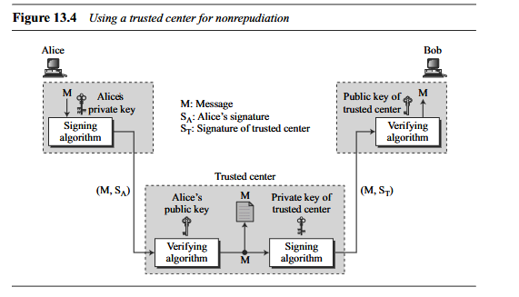
SERVICES (Digital Signature)

Slide 24
SERVICES (Digital Signature)
Diagram Explanation (Figure 13.4 – Trusted Center)
Step-by-step:
1. Alice:
Signs message using private key
Sends:
Message (M)
Signature (Sₐ)
Identity info → to Trusted Center
2. Trusted Center:
Verifies Alice’s signature
Stores a copy
Creates new signature (Sₜ) using its private key
3. Bob:
Receives:
Message
Trusted center’s signature
Verifies using center’s public key

Slide 25
SERVICES (Digital Signature)
✔ Result:
If Alice denies → center proves authenticity
📌 Conclusion:
Nonrepudiation can be achieved using a trusted third party.

Slide 26
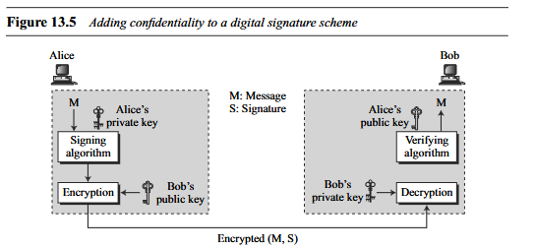
SERVICES (Digital Signature)
Confidentiality
A digital signature does not provide confidential communication. If confidentiality isrequired, the message and the signature must be encrypted using either a secret-key or
public-key cryptosystem. Figure 13.5 shows how this extra level can be added to a simple digital signature scheme.

Slide 27
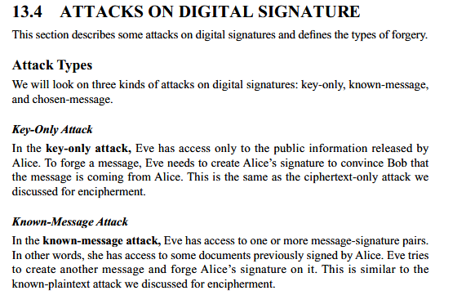
Attacks (Digital Signature)

Slide 28
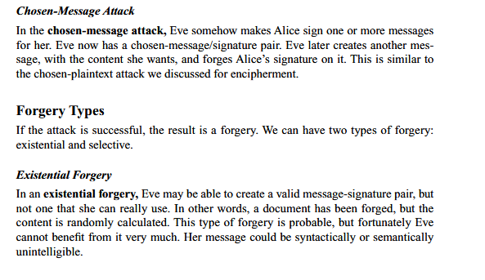

SERVICES (Digital Signature)

Slide 29
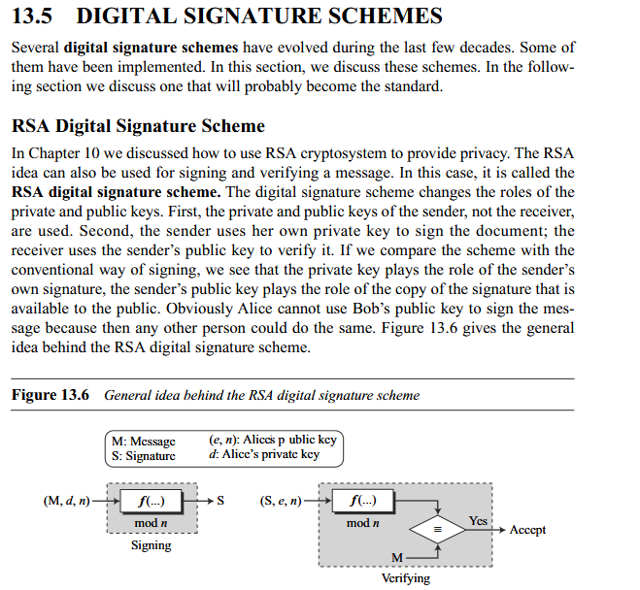
Digital Signature Schemes

Slide 30
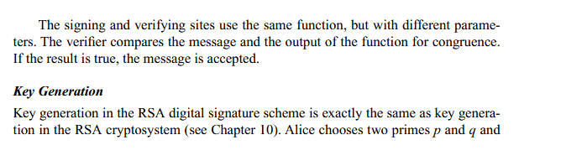
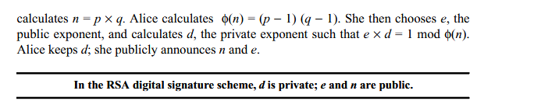
Digital Signature Schemes

Slide 31
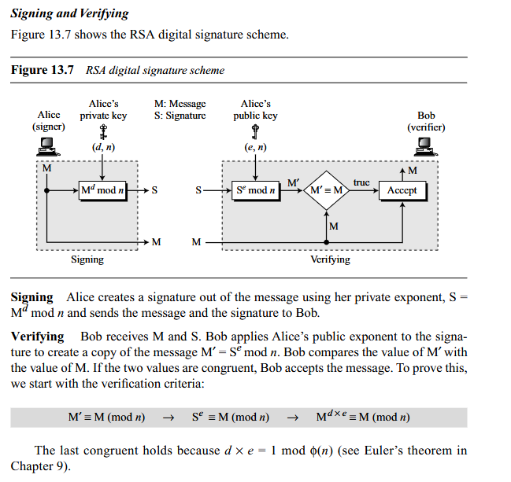
Digital Signature Schemes

Slide 32
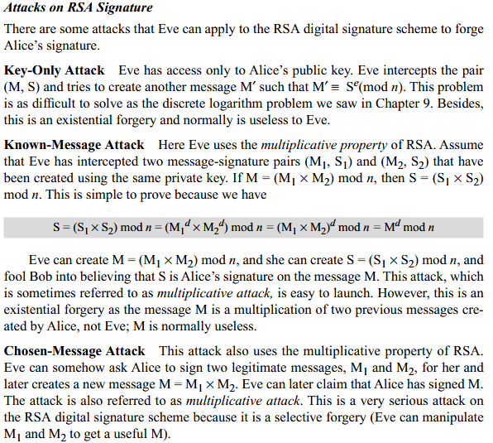
Digital Signature Schemes

Slide 33
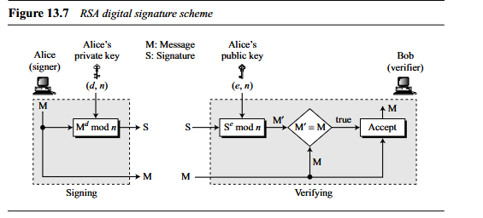
RSA Digital Signature Process

Slide 34
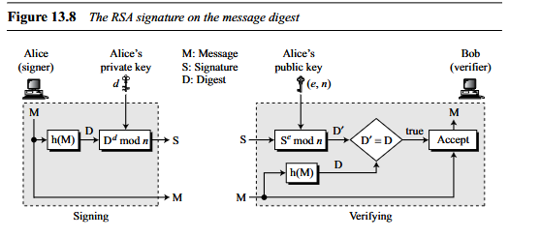

RSA Signature on Message Digest

Slide 35
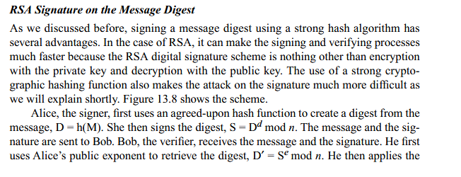
RSA Signature on Message Digest

Slide 36
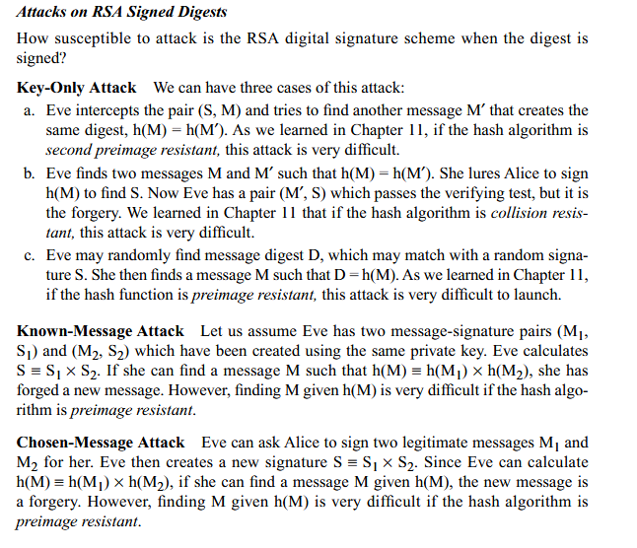

RSA Signature on Message Digest

Slide 37
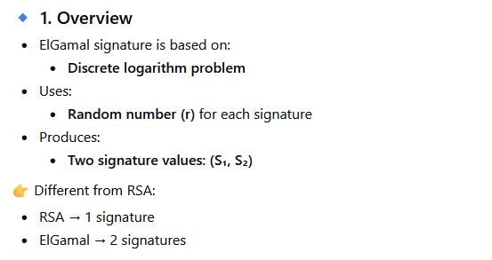
ElGamal Digital Signature Scheme

Slide 38

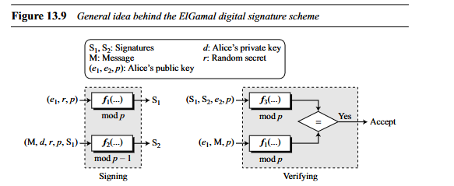

ElGamal Digital Signature Scheme

Slide 39
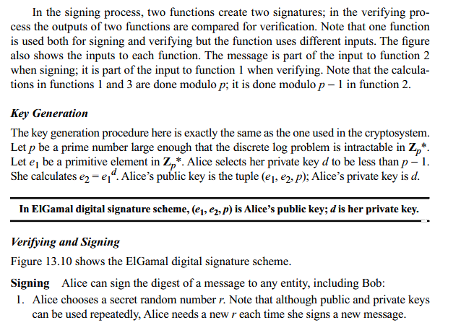
ElGamal Digital Signature Scheme

Slide 40
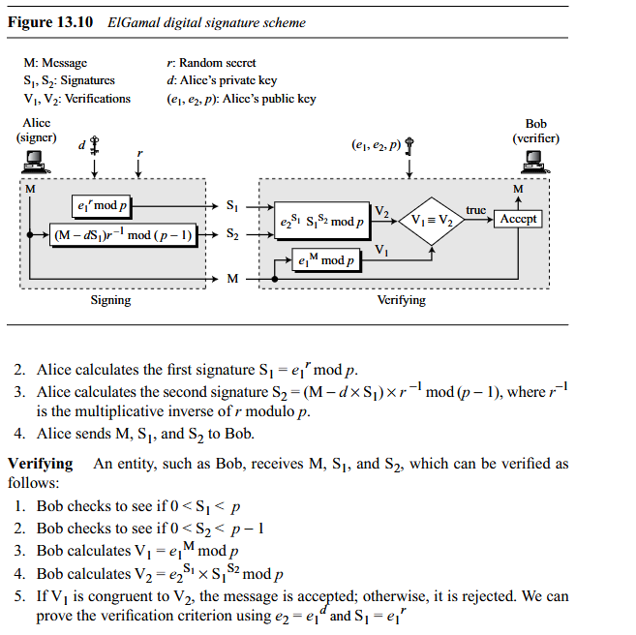
ElGamal Digital Signature Scheme

Slide 41
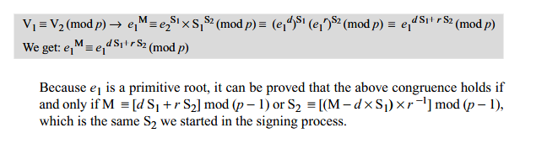
ElGamal Digital Signature Scheme

Slide 42
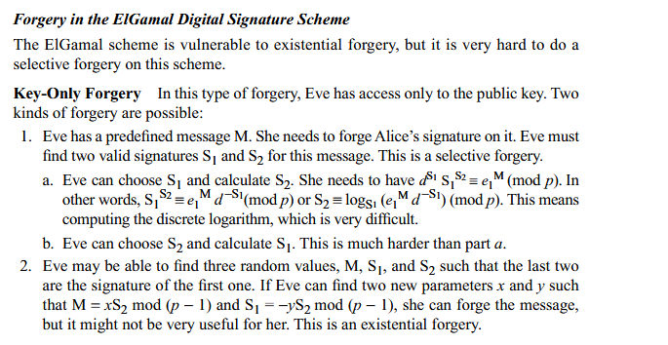
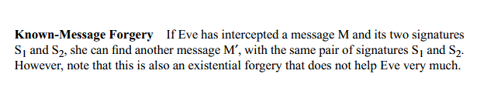
ElGamal Digital Signature Scheme

Slide 43

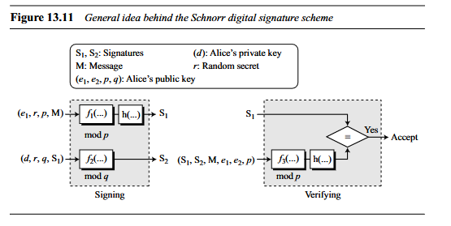
Schnorr Digital Signature Scheme

Slide 44
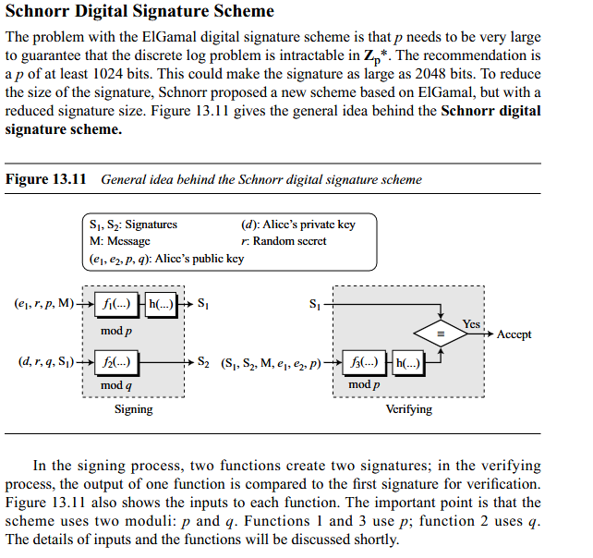
Schnorr Digital Signature Scheme

Slide 45
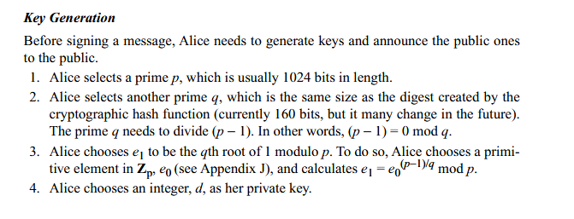

Schnorr Digital Signature Scheme

Slide 46
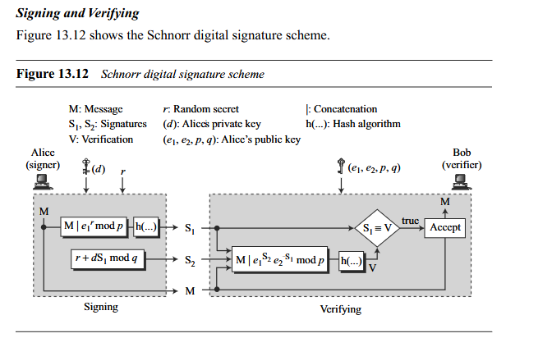
Schnorr Digital Signature Scheme

Slide 47
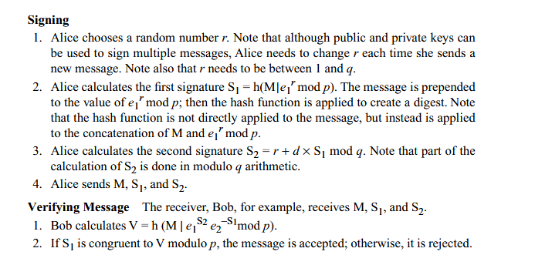
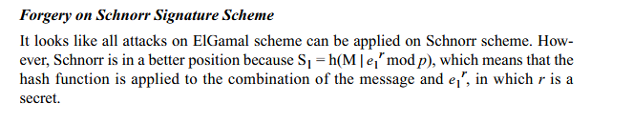
Schnorr Digital Signature Scheme

Slide 48
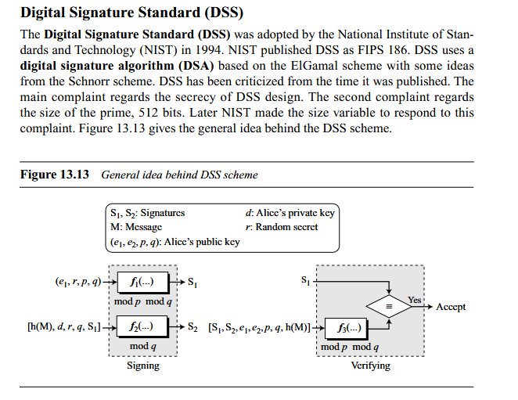
Digital Signature Standard

Slide 49
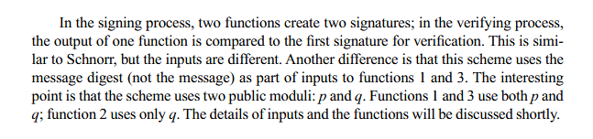
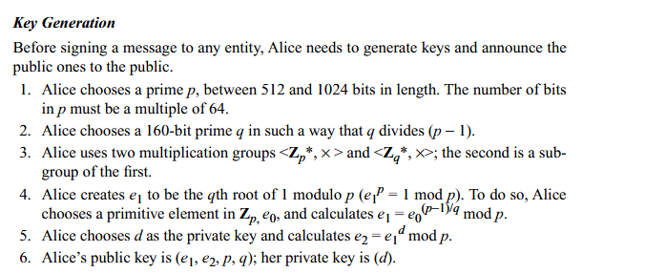
Digital Signature Standard

Slide 50
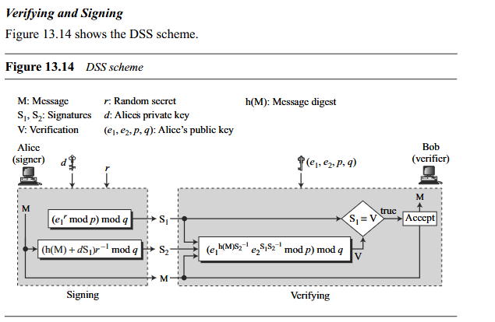
Digital Signature Standard

Slide 51
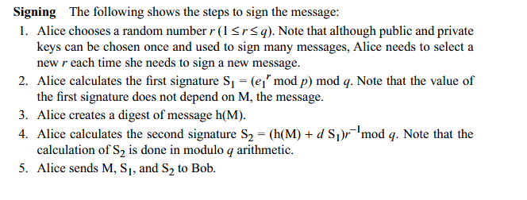
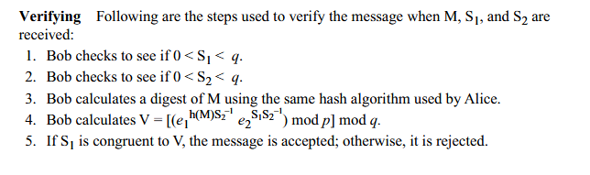
Digital Signature Standard

Slide 52
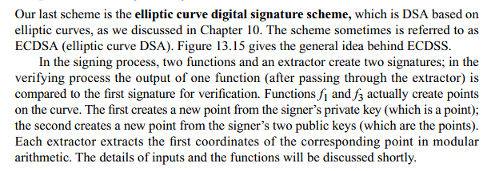
Elliptic Curve Digital Signature Scheme

Slide 53
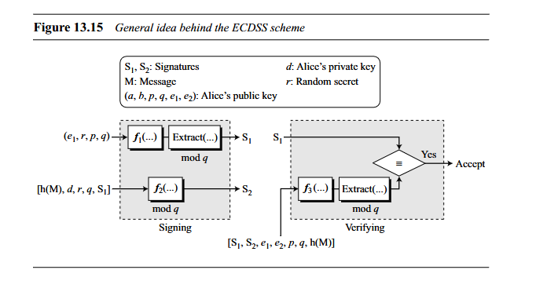
Elliptic Curve Digital Signature Scheme

Slide 54
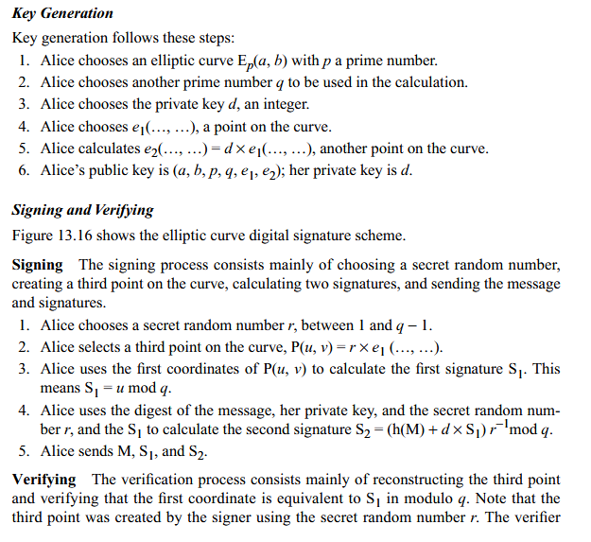
Elliptic Curve Digital Signature Scheme

Slide 55
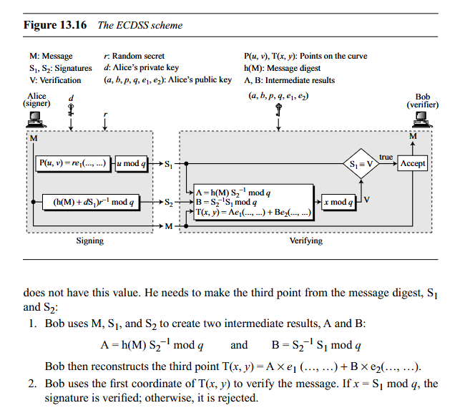
Elliptic Curve Digital Signature Scheme

Slide 56
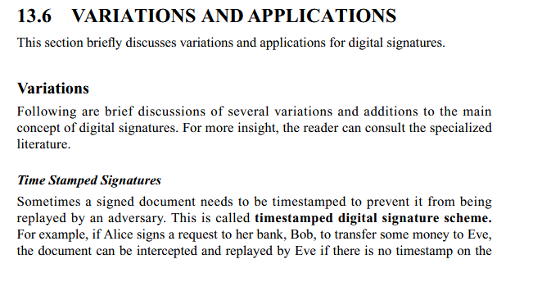
Variations & Applications

Slide 57
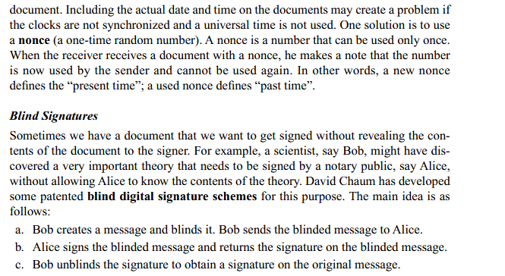
Variations & Applications

Slide 58
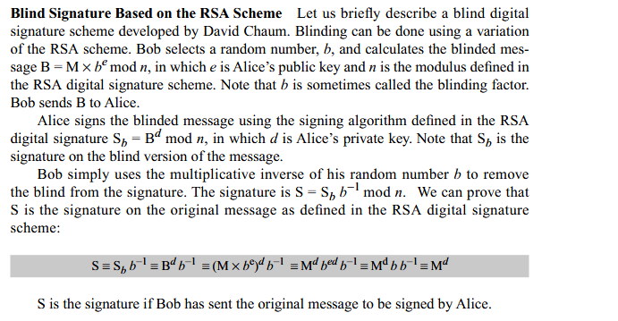
Variations & Applications

Slide 59
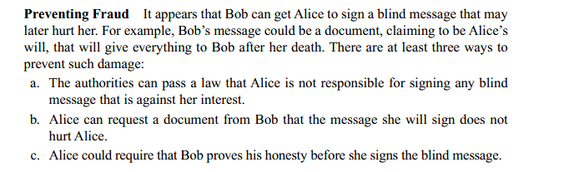
Variations & Applications

Slide 60
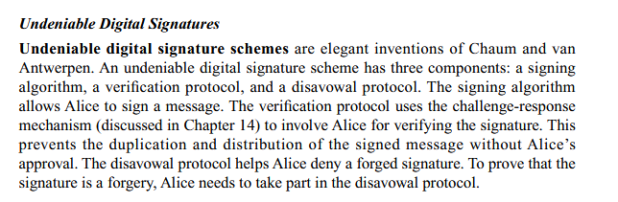
Variations & Applications

